Slide 1
Risk Modelling and Analysis for IT Systems using Probabilistic Graph Rewriting Rules
MSc. Individual Project
Student : Neel Vinod Lad
Project Supervisor : Prof. Reiko Heckel
Principal Marker : Dr. Victoria Wright
Notes:
1

Slide 2
Problem Domain
Modern IT systems are large and complex.
Traditional checklist-based risk assessments cannot keep pace with modern dynamic attacks
How to quantify risk ?
Cascading consequences of multi-stage cyberattacks
For Businesses :
To Spot Loophole
To Predict and Discover an attack
For Externals agents like insurance :
- To get an estimate cost and probabilities of occurrence of an attack over a time period.
Notes:
2

Slide 3
About Project
Bridge the gap between theoretical security models and practical risk.
IT infrastructures are represented as typed, attributed directed multigraphs.
Attack patterns are encoded as graph transformation rules (MITRE ATT&CK FRAMEWORK).
Vulnerability detection through formal graph pattern matching.
By linking attack rates and probabilities to graph rules, the system can estimate how likely an attack is and how severe its impact could be.
Quantitative risk assessments and Stochastic analysis of attacks.
Notes:
3

Slide 4
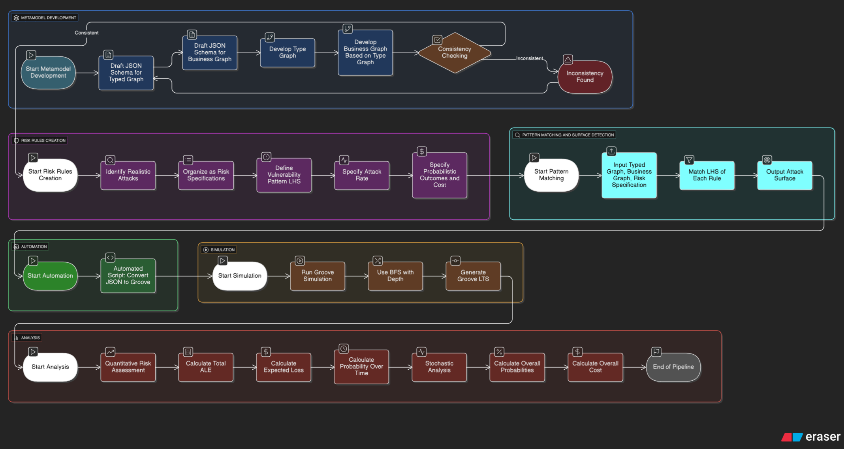
Methodology Pipeline

Slide 5
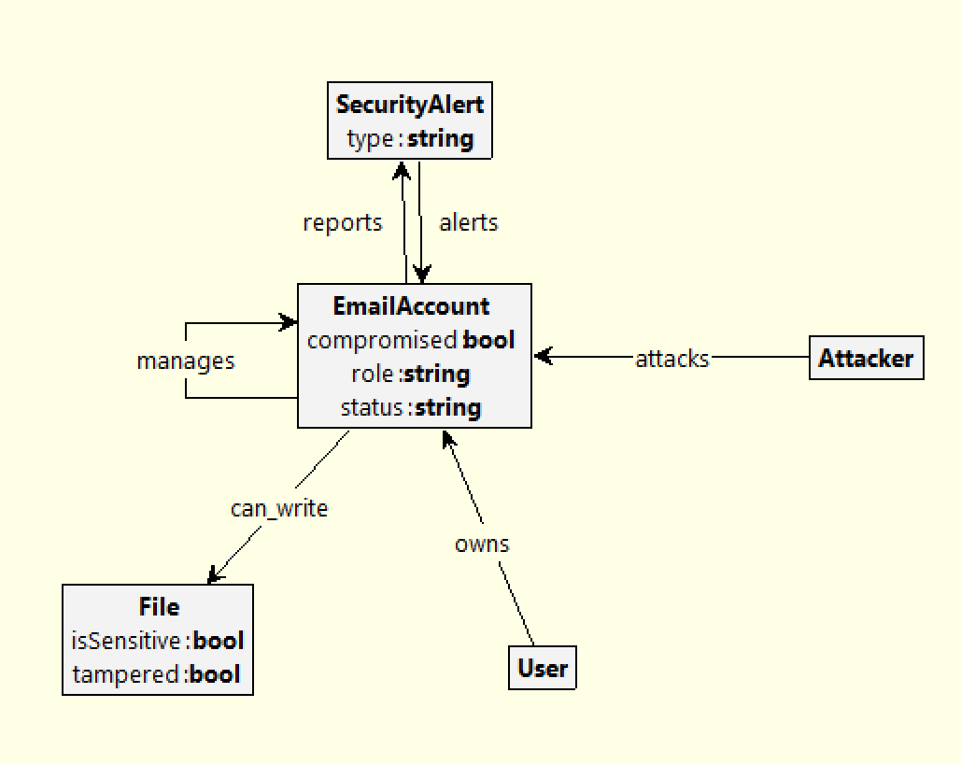
Type of Graph Used in Modelling
Attributed directed type multigraph
Notes:
5

Slide 6
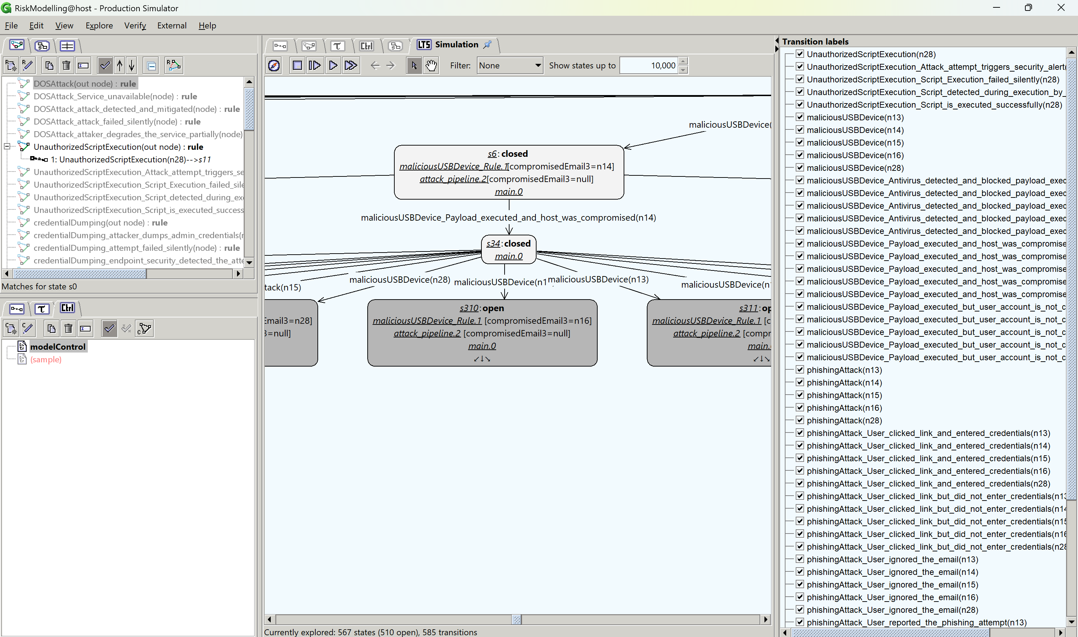
Notes:
6

Slide 7
Fundamental Concepts
Graph Modelling and Transformation [1]
Groove tutorials and terminologies [2]
Quantitative risk assessment
Stochastic Analysis using CTMC.
[1] R. Heckel and G. Taentzer, Graph Transformation for Software Engineers. Springer, 2006.
[2] User Manual for Groove Toolset, https://github.com/nl-utwente-groove/usermanual/blob/master/usermanual.pdf
Notes:
7

Slide 8
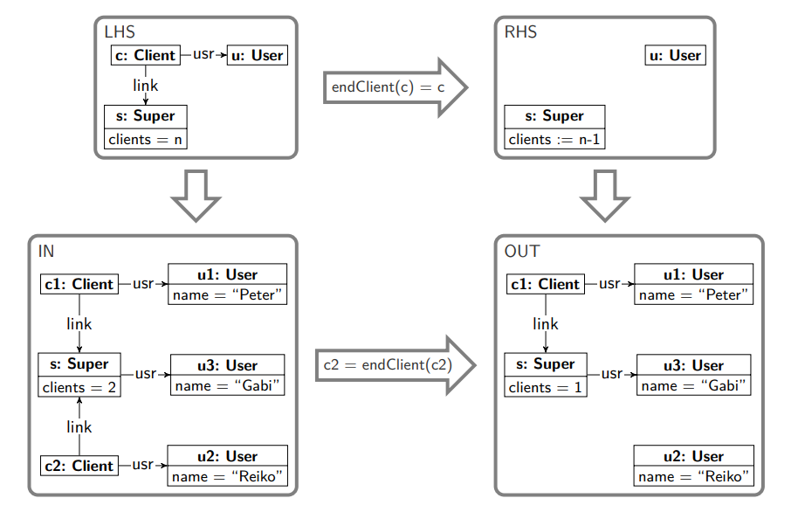
Example of Graph Transformation
From state transformations to rules: graph representation (LHS: left-hand side, RHS: right-hand side) [1]
[1] R. Heckel and G. Taentzer, Graph Transformation for Software Engineers. Springer, 2006.
Notes:
8

Slide 9
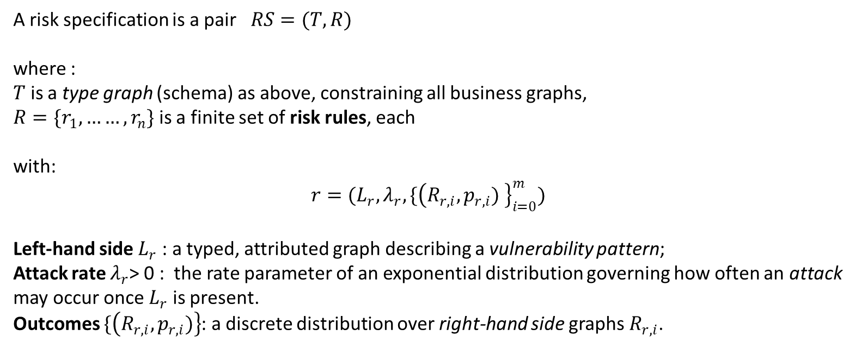
Risk Specification
A risk specification is a pair $RS=(T,R)$
where :
$T$ is a type graph (schema) as above, constraining all business graphs,
$R=\{r_{1},……,r_{n}\}$ is a finite set of risk rules, each
with:
$$r=(L_{r},λ_{r}, \{{\left(R_{r,i},p_{r,i}) \right\}}_{i=0}^{m})$$
Left-hand side $L_{r}$ ​: a typed, attributed graph describing a vulnerability pattern;
Attack rate $λ_{r}$> 0 : the rate parameter of an exponential distribution governing how often an attack may occur once $L_{r}$​ is present.
Outcomes $\{\left(R_{r,i},p_{r,i})\right\}$: a discrete distribution over right-hand side graphs $R_{r,i}$.
Notes:
9

Slide 10
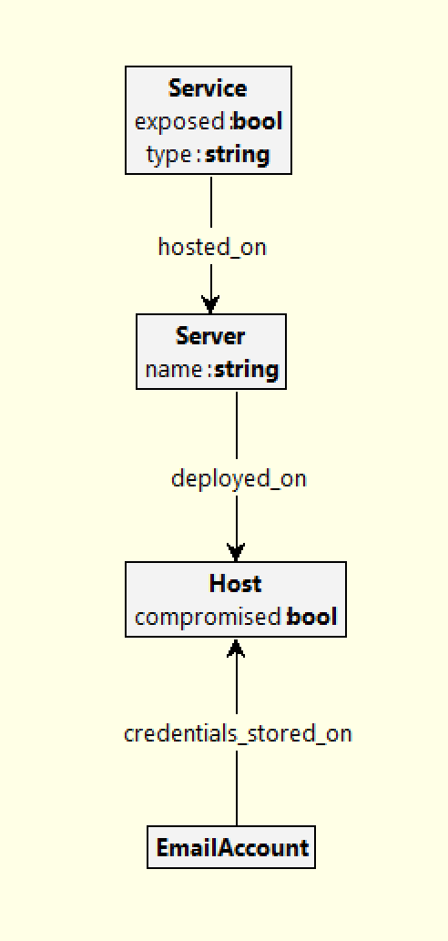
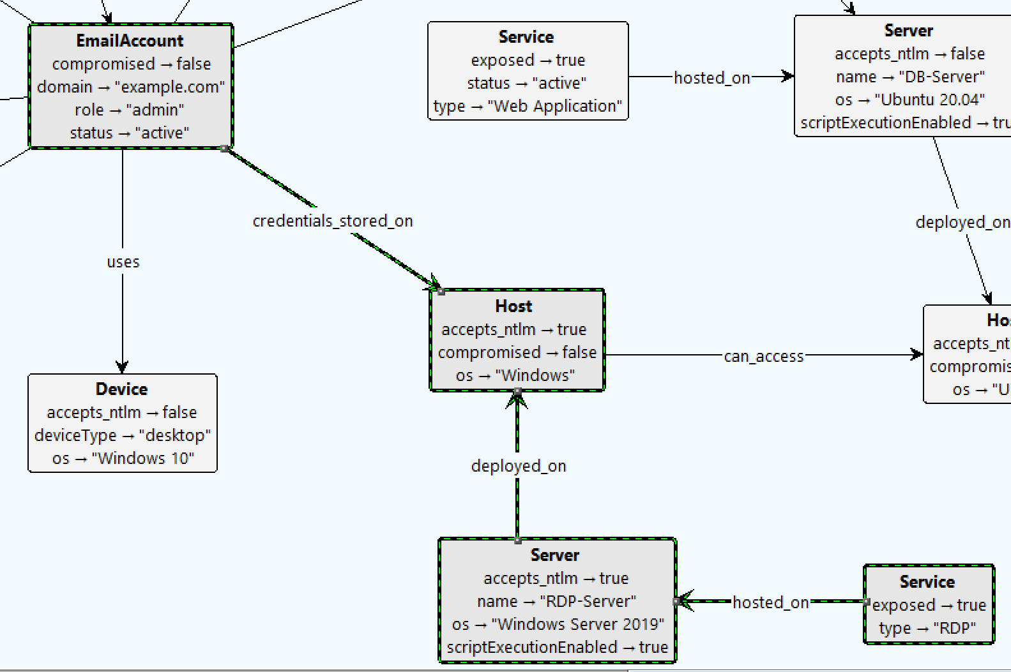
Type graph and Instance Graph
Type Graph
Host Graph (Business Graph) or Instance Graph
Notes:
10

Slide 11
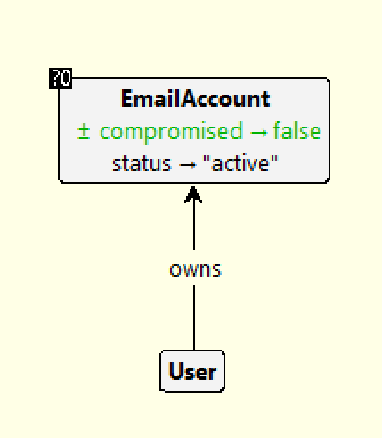
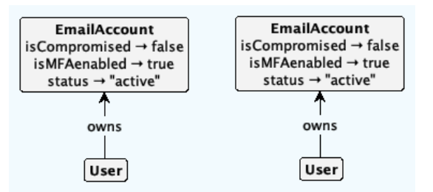
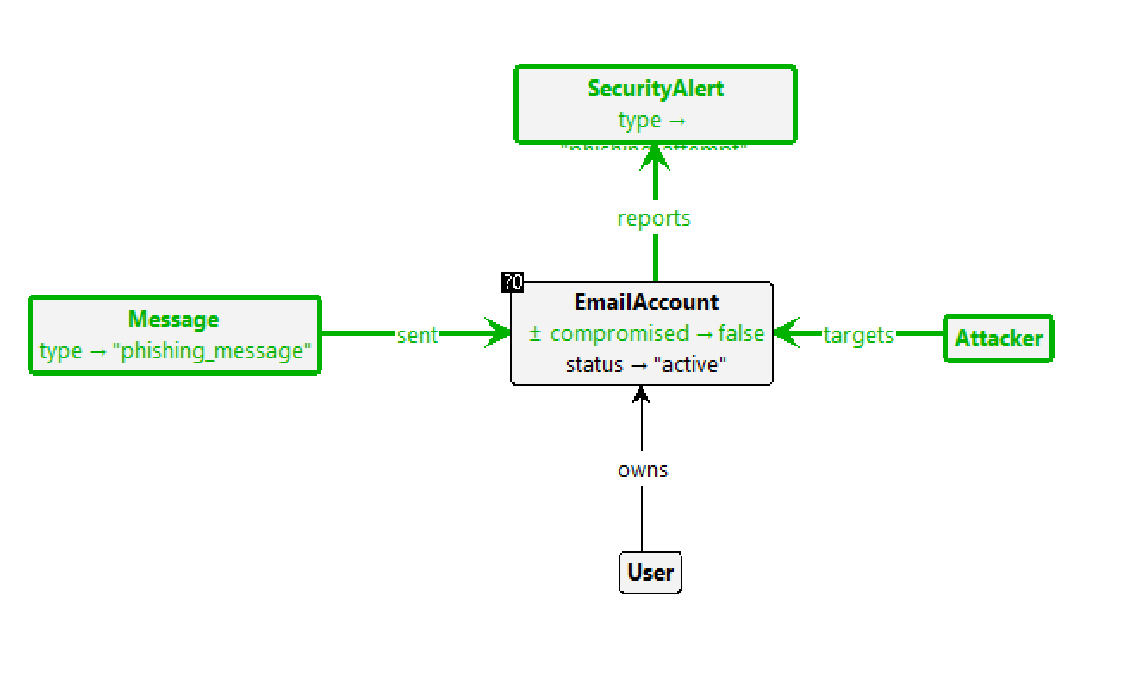
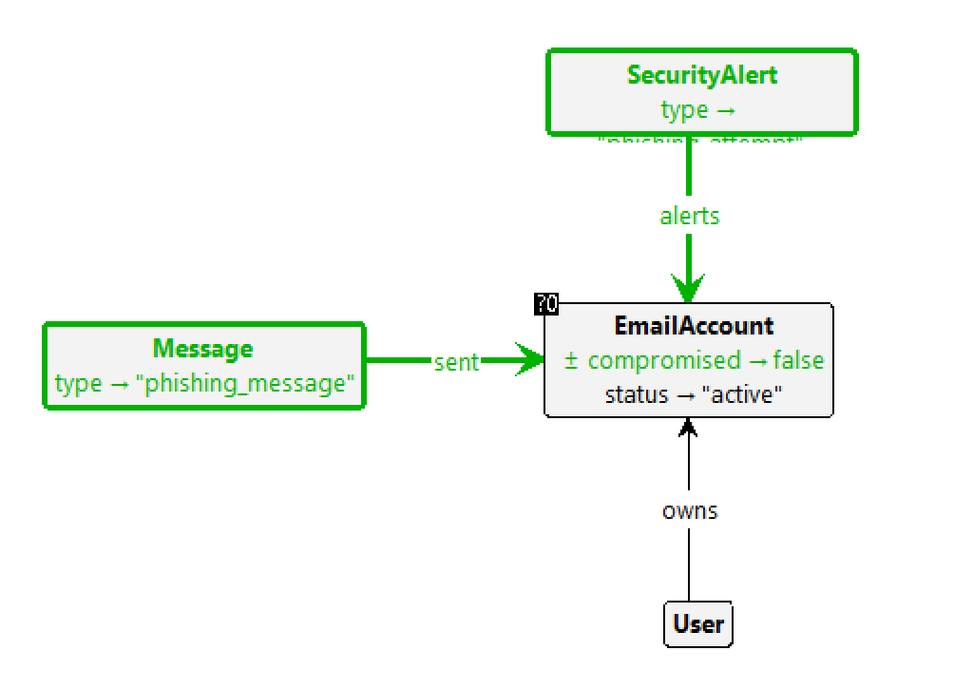
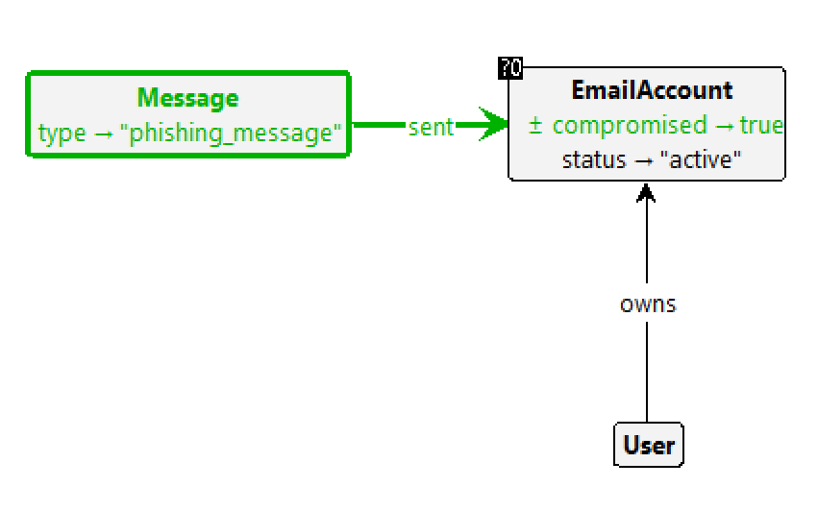
Example of Implementation
Instance Graph
LHS : vulnerability pattern (preconditions)
RHS : outcomes (post conditions)
Output 1 : user clicked the link and account is compromised
Output 2 : user clicked the link and a security alert
Is triggered, but account is not compromised
Output 3 : User ignored the mail, no effects on instance graph
Notes:
11

Slide 12
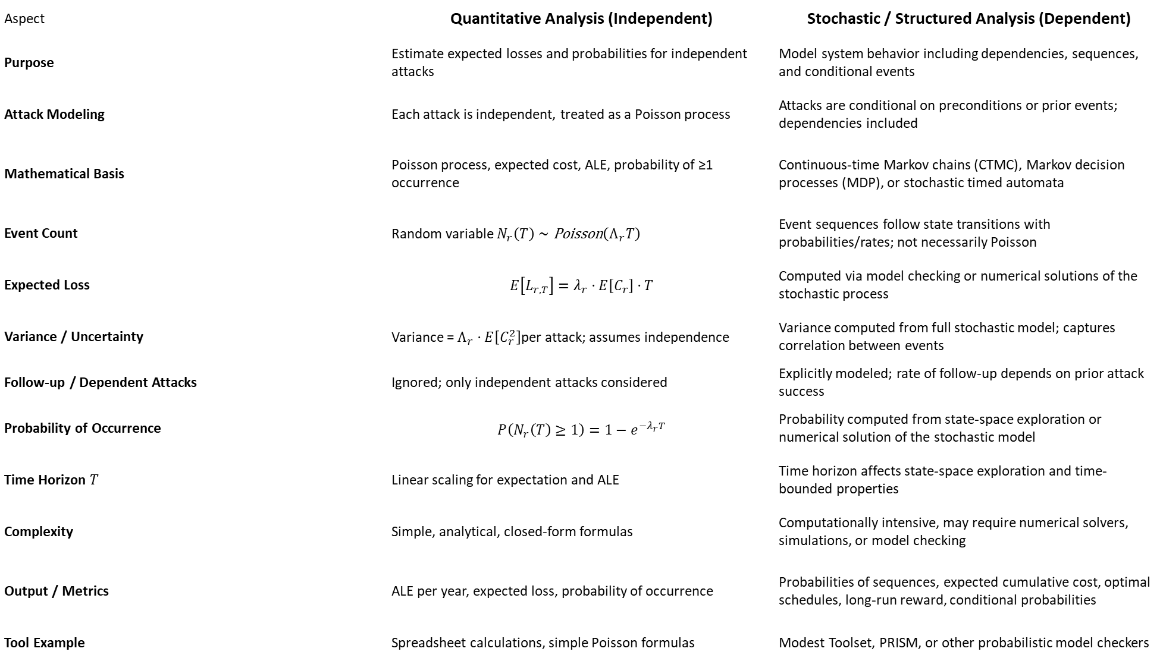
Aspect | Quantitative Analysis (Independent) | Stochastic / Structured Analysis (Dependent)
Purpose | Estimate expected losses and probabilities for independent attacks | Model system behavior including dependencies, sequences, and conditional events
Attack Modeling | Each attack is independent, treated as a Poisson process | Attacks are conditional on preconditions or prior events; dependencies included
Mathematical Basis | Poisson process, expected cost, ALE, probability of ≥1 occurrence | Continuous-time Markov chains (CTMC), Markov decision processes (MDP), or stochastic timed automata
Event Count | Random variable $N_{r}\left(T\right)∼\text{Poisson}\left(Λ_{r}T\right)$ | Event sequences follow state transitions with probabilities/rates; not necessarily Poisson
Expected Loss | $$E\left[L_{r,T}\right]=λ_{r}⋅E\left[C_{r}\right]⋅T$$ | Computed via model checking or numerical solutions of the stochastic process
Variance / Uncertainty | Variance = $Λ_{r}⋅E\left[C_{r}^{2}\right]$per attack; assumes independence | Variance computed from full stochastic model; captures correlation between events
Follow-up / Dependent Attacks | Ignored; only independent attacks considered | Explicitly modeled; rate of follow-up depends on prior attack success
Probability of Occurrence | $$P\left(N_{r}\left(T\right)≥1\right)=1−e^{−λ_{r}T}$$ | Probability computed from state-space exploration or numerical solution of the stochastic model
Time Horizon $T$ | Linear scaling for expectation and ALE | Time horizon affects state-space exploration and time-bounded properties
Complexity | Simple, analytical, closed-form formulas | Computationally intensive, may require numerical solvers, simulations, or model checking
Output / Metrics | ALE per year, expected loss, probability of occurrence | Probabilities of sequences, expected cumulative cost, optimal schedules, long-run reward, conditional probabilities
Tool Example | Spreadsheet calculations, simple Poisson formulas | Modest Toolset, PRISM, or other probabilistic model checkers
Notes:
12

Slide 13
Quantitative risk Estimation
( Structure Free analysis only for attacks that occur independently)
We assume attacks happen randomly but independently.
The number of attacks per year is described by a Poisson process.
We calculate the average cost of every attack.
Multiplying the attack rate by this cost gives the expected yearly loss.
We can also compute the probability of at least one attack within a given time.
Notes:
13

Slide 14
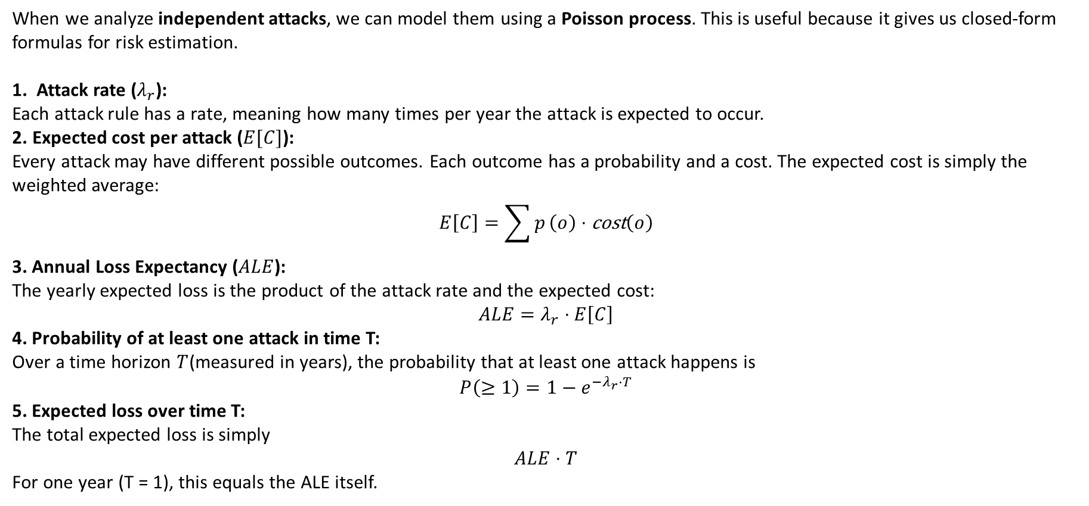
Quantitative risk Estimation
( Structure Free analysis only for attacks that occur independently)
When we analyze independent attacks, we can model them using a Poisson process. This is useful because it gives us closed-form formulas for risk estimation.
Attack rate ($λ_{r}$): Each attack rule has a rate, meaning how many times per year the attack is expected to occur.
Expected cost per attack ($E[C]$): Every attack may have different possible outcomes. Each outcome has a probability and a cost. The expected cost is simply the weighted average:
$$E\left[C\right]=\sum{p}\left(o\right)⋅\text{cost}\left(o\right)$$
3. Annual Loss Expectancy ($ALE$): The yearly expected loss is the product of the attack rate and the expected cost:
$$ALE=λ_{r}⋅E\left[C\right]$$
4. Probability of at least one attack in time T: Over a time horizon $T$(measured in years), the probability that at least one attack happens is
$$P\left(≥1\right)=1−e^{−λ_{r}⋅T}$$
5. Expected loss over time T: The total expected loss is simply
$$ALE⋅T$$
For one year (T = 1), this equals the ALE itself.
Notes:
14

Slide 15
Stochastic Analysis of the Risk Model
Aspect | CTMC | CTMDP
Decisions | No choices, purely probabilistic | Allows decisions at key points (strategies matter)
Transitions | Fixed rates, exponential timing | Multiple actions per state, each with rates
Complexity | Simpler, smaller state-space | Larger, due to nondeterminism and strategies
Use Case | Reliability, availability, expected costs | Optimize policies, best/worst-case outcomes
Metrics | Probabilities, expected counts, cumulative rewards | Optimal expected rewards, policy-dependent probabilities
Key Advantage | Easy to compute and understand | Captures decision-making and control under uncertainty
Notes:
15

Slide 16
Stochastic Analysis of the Risk Model
CTMC : Collapsed rate approach
Immediate outcomes must be purely probabilistic: neither attacker nor defender can choose among them.
There should be no extra nondeterminism.
Vanishing chains of immediate outcomes are collapsed into a single probability distribution over terminal states.
This guarantees that collapsing fragments preserves:
a) Time-bounded reachability
b) Expected cumulative rewards
Notes:
16

Slide 17
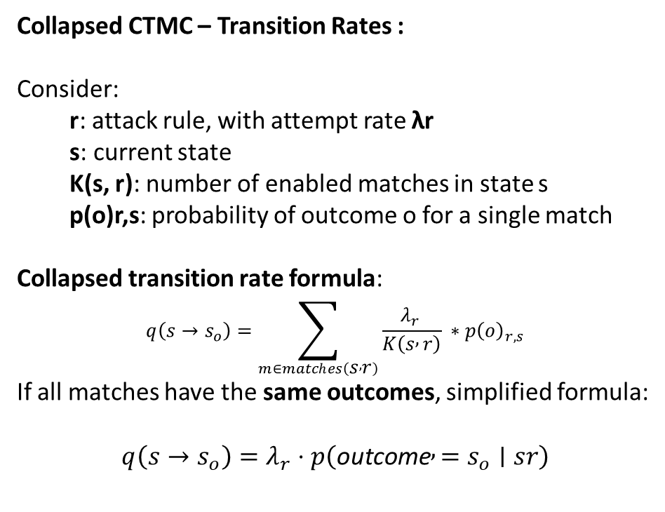
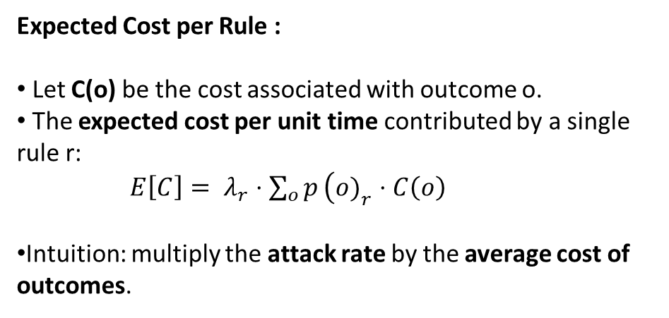
Stochastic Analysis of the Risk Model
Collapsed CTMC – Transition Rates :
Consider:
r: attack rule, with attempt rate λr
s: current state
K(s, r): number of enabled matches in state s
p(o)r,s: probability of outcome o for a single match
Collapsed transition rate formula:
$$q\left(s→s_{o}\right)=\sum_{m∈matches\left(s , r\right)}{\frac{λ_{r }}{K\left(s , r\right)} ∗p{\left(o\right)}_{r,s}}$$
If all matches have the same outcomes, simplified formula:
$$q\left(s→s_{o}\right)=λ_{r}⋅p\left(\text{outcome} , =s_{o}∣sr\right)$$
Expected Cost per Rule :
Let C(o) be the cost associated with outcome o.
The expected cost per unit time contributed by a single rule r:
${E\left[C\right]= λ}_{r}⋅\sum_{o}{p}\left(o{\left.)\right.}_{r}⋅C\left(o\right)\right.$
Intuition: multiply the attack rate by the average cost of outcomes.
Notes:
17

Slide 18
Stochastic Analysis of the Risk Model
Properties Verified : 1. P =?[F <= 1.0 "harm"] This property asks: “What is the probability that the system experiences the ‘harm’ event within 1.0 time units?” It tells us how likely it is that a risky or harmful event occurs within a given short time horizon.
2. R{"cost"} =?[C <= 1.0] This property asks: “What is the expected accumulated cost over 1.0 time units?” It quantifies the average impact or loss due to events in the system during that period.
Thus,
The first property measures the risk likelihood of a harmful event in a short timeframe.
The second property measures the expected impact or cost from events during the same timeframe.
Notes:
18

Slide 19
Challenges
Modelling a large-scale IT systems as attributed graphs can lead to scalability and computational complexity.
Risk analysis accuracy depends on high-quality, up-to-date system data, which may be lacking in practice.
Purely probabilistic, cannot model decisions or policy choices.
Handling rare events may require approximations or long simulation times.
Interpretability and actionability of results is vital for practical adoption.
Notes:
19

Slide 20
Thank You
Notes:
20

